Slide 1
Angular - Databinding
Peter Eijgermans peter.eijgermans@ordina.nl

Slide 2


What is databinding?
Show data in the user interface
Data comes from :
Controller / class
Customer Products
Articles
Database
User input
Other systems
s
{ JSON }

Slide 3
Declarative syntaxis
New syntax in HTML-views/partials.
Simple data binding
Event binding
One-way data binding
Two-way data binding
AngularJS:
Views are standalone HTML-documents. Via routers/hyperlinks the Views are connected
Angular:
View is coopled to a component

Slide 4
Simple data binding syntaxis
<div>Stad: {{ city }}</div>
<div>Voornaam: {{ person.firstname }}</div>

Slide 5
Usage in component/class
import {Component} from '@angular/core';
@Component({
selector: 'hello‐world',
template: `<h1>Hello Angular 7</h1>
<h2>Mijn naam is : {{ name }}</h2>
<h2>Mijn favoriete stad is : {{ city }}</h2>
`
})
export class AppComponent {
name = 'Peter Eijgermans’;
city = 'Groningen'
}

Slide 6
Or: properties via constructor
export class AppComponent { name: string;
city: string;
constructor() {
this.name = 'Peter Eijgermans'; this.city = 'Groningen'
}
}

Slide 7
Binden via a loop: *ngFor
Template:
<h2>Mijn favoriete steden zijn :</h2>
<ul>
<li *ngFor=”let city of cities">{{ city }}</li>
</ul>
Class:
// Class with properties, array with cities
export class AppComponent { name:string;
cities:string[];
constructor() {
this.name | = | 'Peter Eijgermans';
this.cities | = | ['Groningen', 'Hengelo', | 'Den Haag', 'Enschede']
}
}

Slide 8
Use OnInit Lifecyclehook
Template:
<h2>Mijn favoriete steden zijn :</h2>
<ul>
<li *ngFor=”let city of cities">{{ city }}</li>
</ul>
Class:
export class AppComponent implements OnInit { name:string;
cities:string[];
constructor() {}
ngOnInit ( ) {
this.name | = | 'Peter Eijgermans';
this.cities | = | ['Groningen', 'Hengelo', | 'Den Haag', 'Enschede']
}
}

Slide 9
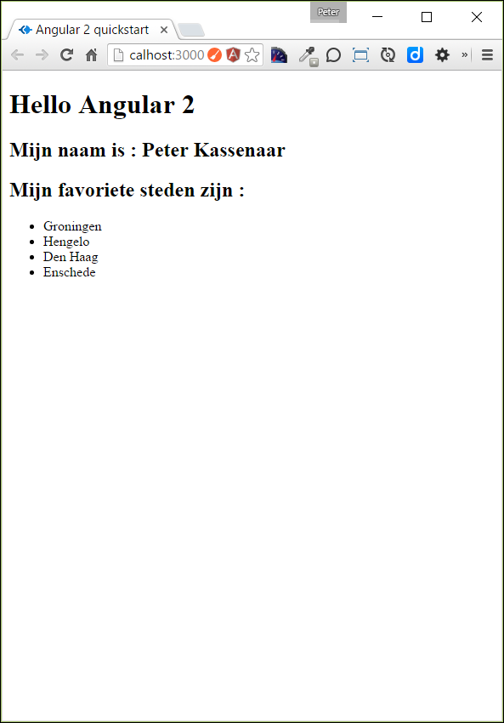

Slide 10
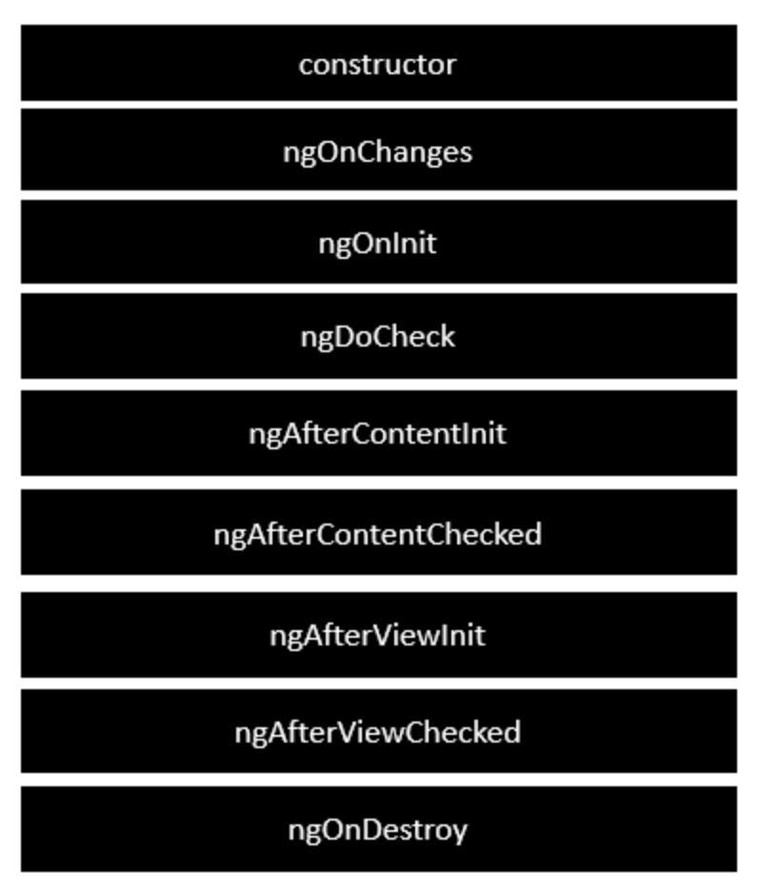
Life Cycle Hooks
Notes:
Following is a description of each lifecycle hook.
ngOnChanges − When the value of a data bound property changes, then this method is called.
ngOnInit − This is called whenever the initialization of the directive/component after Angular first displays the data-bound properties happens.
ngDoCheck − This is for the detection and to act on changes that Angular can't or won't detect on its own.
ngAfterContentInit − This is called in response after Angular projects external content into the component's view.
ngAfterContentChecked − This is called in response after Angular checks the content projected into the component.
ngAfterViewInit − This is called in response after Angular initializes the component's views and child views.
ngAfterViewChecked − This is called in response after Angular checks the component's views and child views.
ngOnDestroy − This is the cleanup phase just before Angular destroys the directive/component.

Slide 11
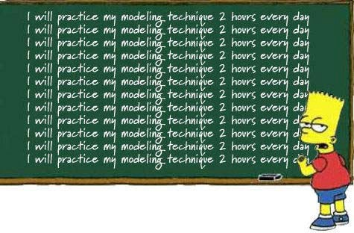
Checkpoint
Simple data binding {{ … }}
Properties binding
Loops via *ngFor
See 2a + 2b
Exercise….

Slide 12
Make a Model
Export a Class with properties:
export class City{
constructor(
public id: number, public name: string,
public province: string,
){ }
}

Slide 13
Use a Model
1. Import Model-class in your Component
import {City} from './city.model'
Change Component
export class AppComponent {
name = 'Peter Eijgermans';
cities =[
new City(1, 'Groningen', 'Groningen'),
new City(2, 'Hengelo', 'Overijssel'),
new City(3, 'Den Haag', 'Zuid‐Holland'),
new City(4, 'Enschede', 'Overijssel'),
]
}
Change View
<li *ngFor=”let city of cities">{{ city.id}} ‐ {{ city.name }}</li>

Slide 14
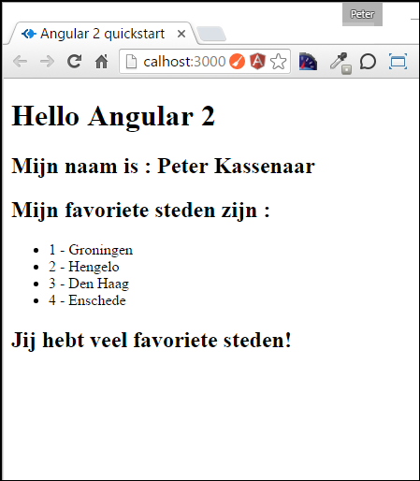
Conditional statement *ngIf
Use directive *ngIf (use a star!)
<h2 *ngIf="cities.length > 3">Jij hebt veel favoriete steden!</h2>

Slide 15
External templates
Call external templates:
@Component({
selector : 'hello‐world', templateUrl: 'app/app.html'
})
Make external template app.html:
<!‐‐ HTML in externe template ‐‐>
<h1>Hello Angular 2</h1>
<p>Dit is een externe template</p>
<h2>Mijn naam is : {{ name }}</h2>
<h2>Mijn favoriete steden zijn :</h2>
…

Slide 16
Checkpoint
Conditional statement via *ngIf
External HTML-templates
Use Model
See 2c + 2d + 2e
Exercise….

Slide 17
User input en event binding
React on op mouse-clicks, keyboard, hyperlinks ect…

Slide 18
Event binding syntaxis
Use round brackets for events:
<div
(click)=“handleClick()”>…</div>
<div
(blur)=“onBlur()”>…</div>
P.80

Slide 19
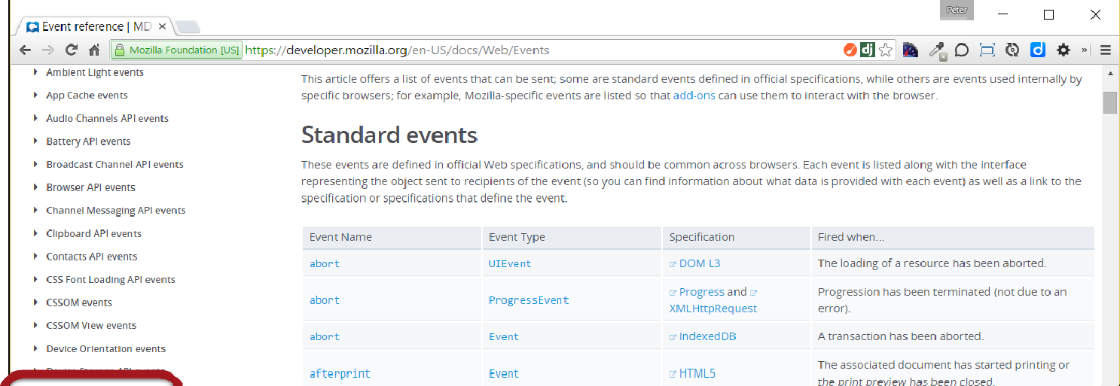
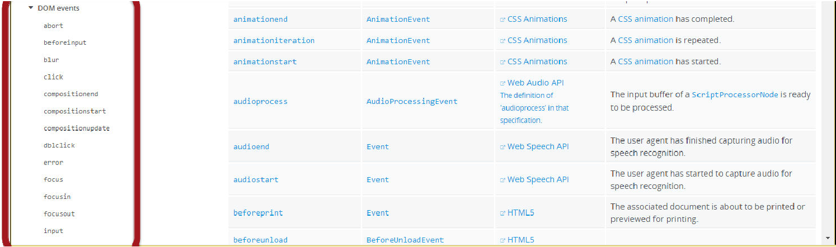
DOM-events
https://developer.mozilla.org/en-US/docs/Web/Events

Slide 20
Event binding
HTML
<!‐‐ Event binding voor een button ‐‐>
<button class="btn btn‐success"
(click)="btnClick()">Ik ben een button</button>
Class
export class AppComponent {
counter: number =0;
btnClick(){
alert('Je hebt '+ ++this.counter +' keer geklikt');
}
}

Slide 21
Event binding with $event
HTML
<input type="text" class="input‐lg" placeholder="Plaatsnaam..." (keyup)="onKeyUp($event)"><br>
<p>{{ txtKeyUp}}</p>
Class
// 2. Binden aan keyUp‐event in de textbox
onKeyUp(event:any){
this.txtKeyUp = event.target.value + ' ‐ ';
}
(
Notes:
Probleem: event is niet strongly typed. Als je dat echter wel doet, wordt de class veel minder portable
Oplossing: gebruik local template variable ( zeg maar een soort “id” voor het element)

Slide 22
Checkpoint
Event binding with(eventName)=“…”
Use an event handler-function in the component
See 3a + 3b
Exercise….

Slide 23
Binding with local template variable
Declare a local template variable with # → The whole element is then available in the component
Attention: bind to the event!
<input type="text" class="input‐lg" placeholder="Plaatsnaam..."
#txtCity (keyup)="betterKeyUp()">
<h3>{{ txtCity.value }}</h3>
Class:
// 3. Binden aan keyUp‐event via local template variable
betterKeyUp(){
//... do nothing, for now
}

Slide 24
Local template variable
HTML
<input type="text" class="input‐lg" placeholder="Plaatsnaam..." #txtCity>
<button class="btn btn‐success"
(click)="addCity(txtCity)">Toevoegen
</button>
Class
export class AppComponent {
// Properties voor de component/class
…
addCity(txtCity) {
let newID = this.cities.length + 1;
let newCity = new City(newID, txtCity.value, 'Onbekend'); this.cities.push(newCity);
txtCity.value = '';
}
}

Slide 25
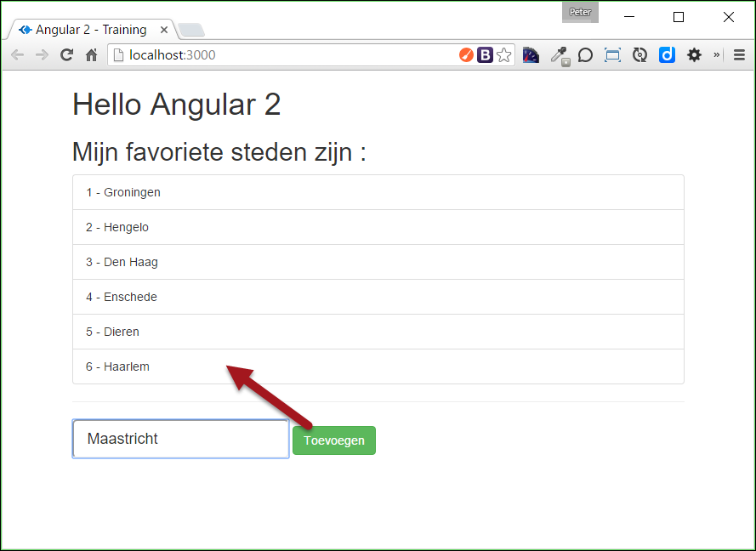
Verder lezen/meer informatie: https://angular.io/docs/ts/latest/guide/user-input.html
24

Slide 26
Checkpoint Event binding
Event binding with(eventName)=“…”
Use an event handler-function in the component
Use # to declare the local template variable
Make simple CRUD-operations.
See 3c + 3d
Exercise….

Slide 27
Attribute & property binding

Slide 28
Attribute binding syntaxis
Bind to properties of HTML-elements.
Also called: one-way binding
Use these brackets: []
<div
[hidden]=“true”>…</div>
Or :
<div [hidden]=“person.hasEmail”>…</div>
<div [style.background-color]=“yellow”>…</div>

Slide 29
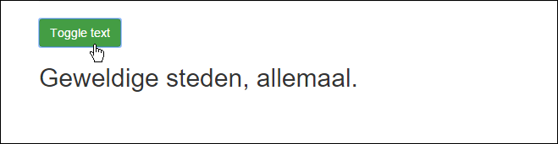
Example attribute binding
HTML
<!‐‐ Attribute binding ‐‐>
<button class="btn btn‐success" (click)="toggleText()">Toggle text</button>
<h2 [hidden]="textVisible">Geweldige steden, allemaal.</h2>
Class
// attribuut toggelen: tekst zichtbaar/onzichtbaar maken.
toggleText(){
this.textVisible = !this.textVisible;
}

Slide 30
Example…
HTML
<li *ngFor="let city of cities" class="list‐group‐item" (click)="updateCity(city)">
{{ city.id}} ‐ {{ city.name }}
</li>
Class
export class AppComponent {
// …
currentCity:City cityPhoto:string
= null;
= '';
// Geselecteerde city updaten in de ui. Nieuw : ES6 String interpolation
updateCity(city:City) {
this.currentCity = city;
this.cityPhoto = `img/${this.currentCity.name}.jpg`;
}
}

Slide 31
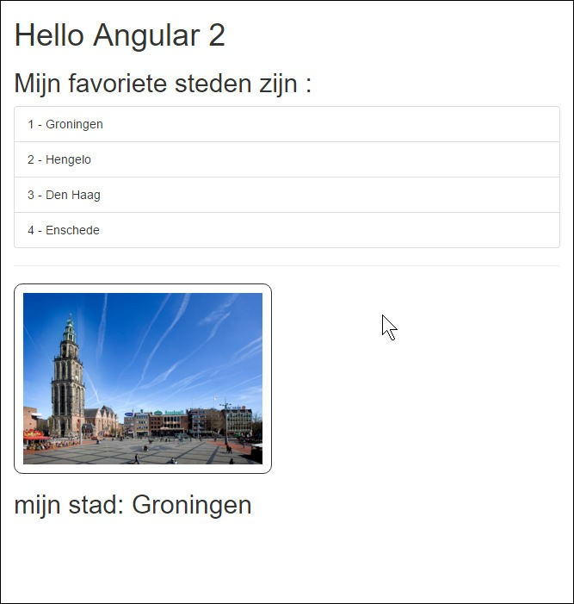
Demo:
..\04-attributebinding\app\app-02.html en
..\app-02.component.ts
Meer informatie: https://angular.io/docs/ts/latest/guide/template-syntax.html#!#property-binding

Slide 32
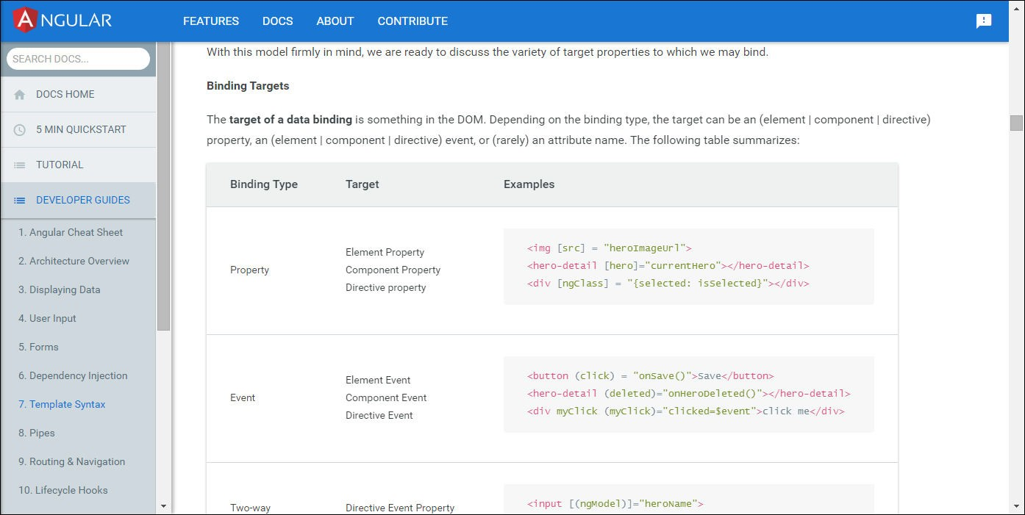
More binding-options
Attribute binding en DOM-property binding
Class binding : [ngClass]
Style binding : [ngStyle]
https://angular.io/docs/ts/latest/guide/template-syntax.html

Slide 33
Checkpoint Attribute & property binding
See 4a + 4b
Oefening….

Slide 34
Two-way binding
Update User interface and state directly

Slide 35
Two way binding syntaxis
<input
[(ngModel)]=“person.firstName” />

Slide 36
[(ngModel)]
HTML
<input type="text" class="input‐lg" [(ngModel)]="newCity" />
<h2>{{ newCity }}</h2>
Dat is shorthand-notatie voor:
<!‐‐ Two‐way binding met uitgebreide syntaxis‐‐>
<input type="text" class="input‐lg" [value]="newCityExtended" (input)="newCityExtended = $event.target.value" />
<h2>{{ newCityExtended }}</h2>

Slide 37
Import FormsModule for [(ngModel)] in app.module.ts
import
• …
{FormsModule}
from "@angular/forms";

Slide 38
Checkpoint two way databinding
See 4c
Exercise….

